Slide 1
Crowd Canvass Sprint Update
Shayne Burns,
Ramzi Carter,
Wylie Frydrychowicz,
Max Rothweiler, &
Hannibal Santiago

Slide 2

Goals for Past 2 Week Sprint
Research and select the most optimal database
Set up the database and connect it to our web application
Reformat web application to be more aesthetically appealing

Slide 3
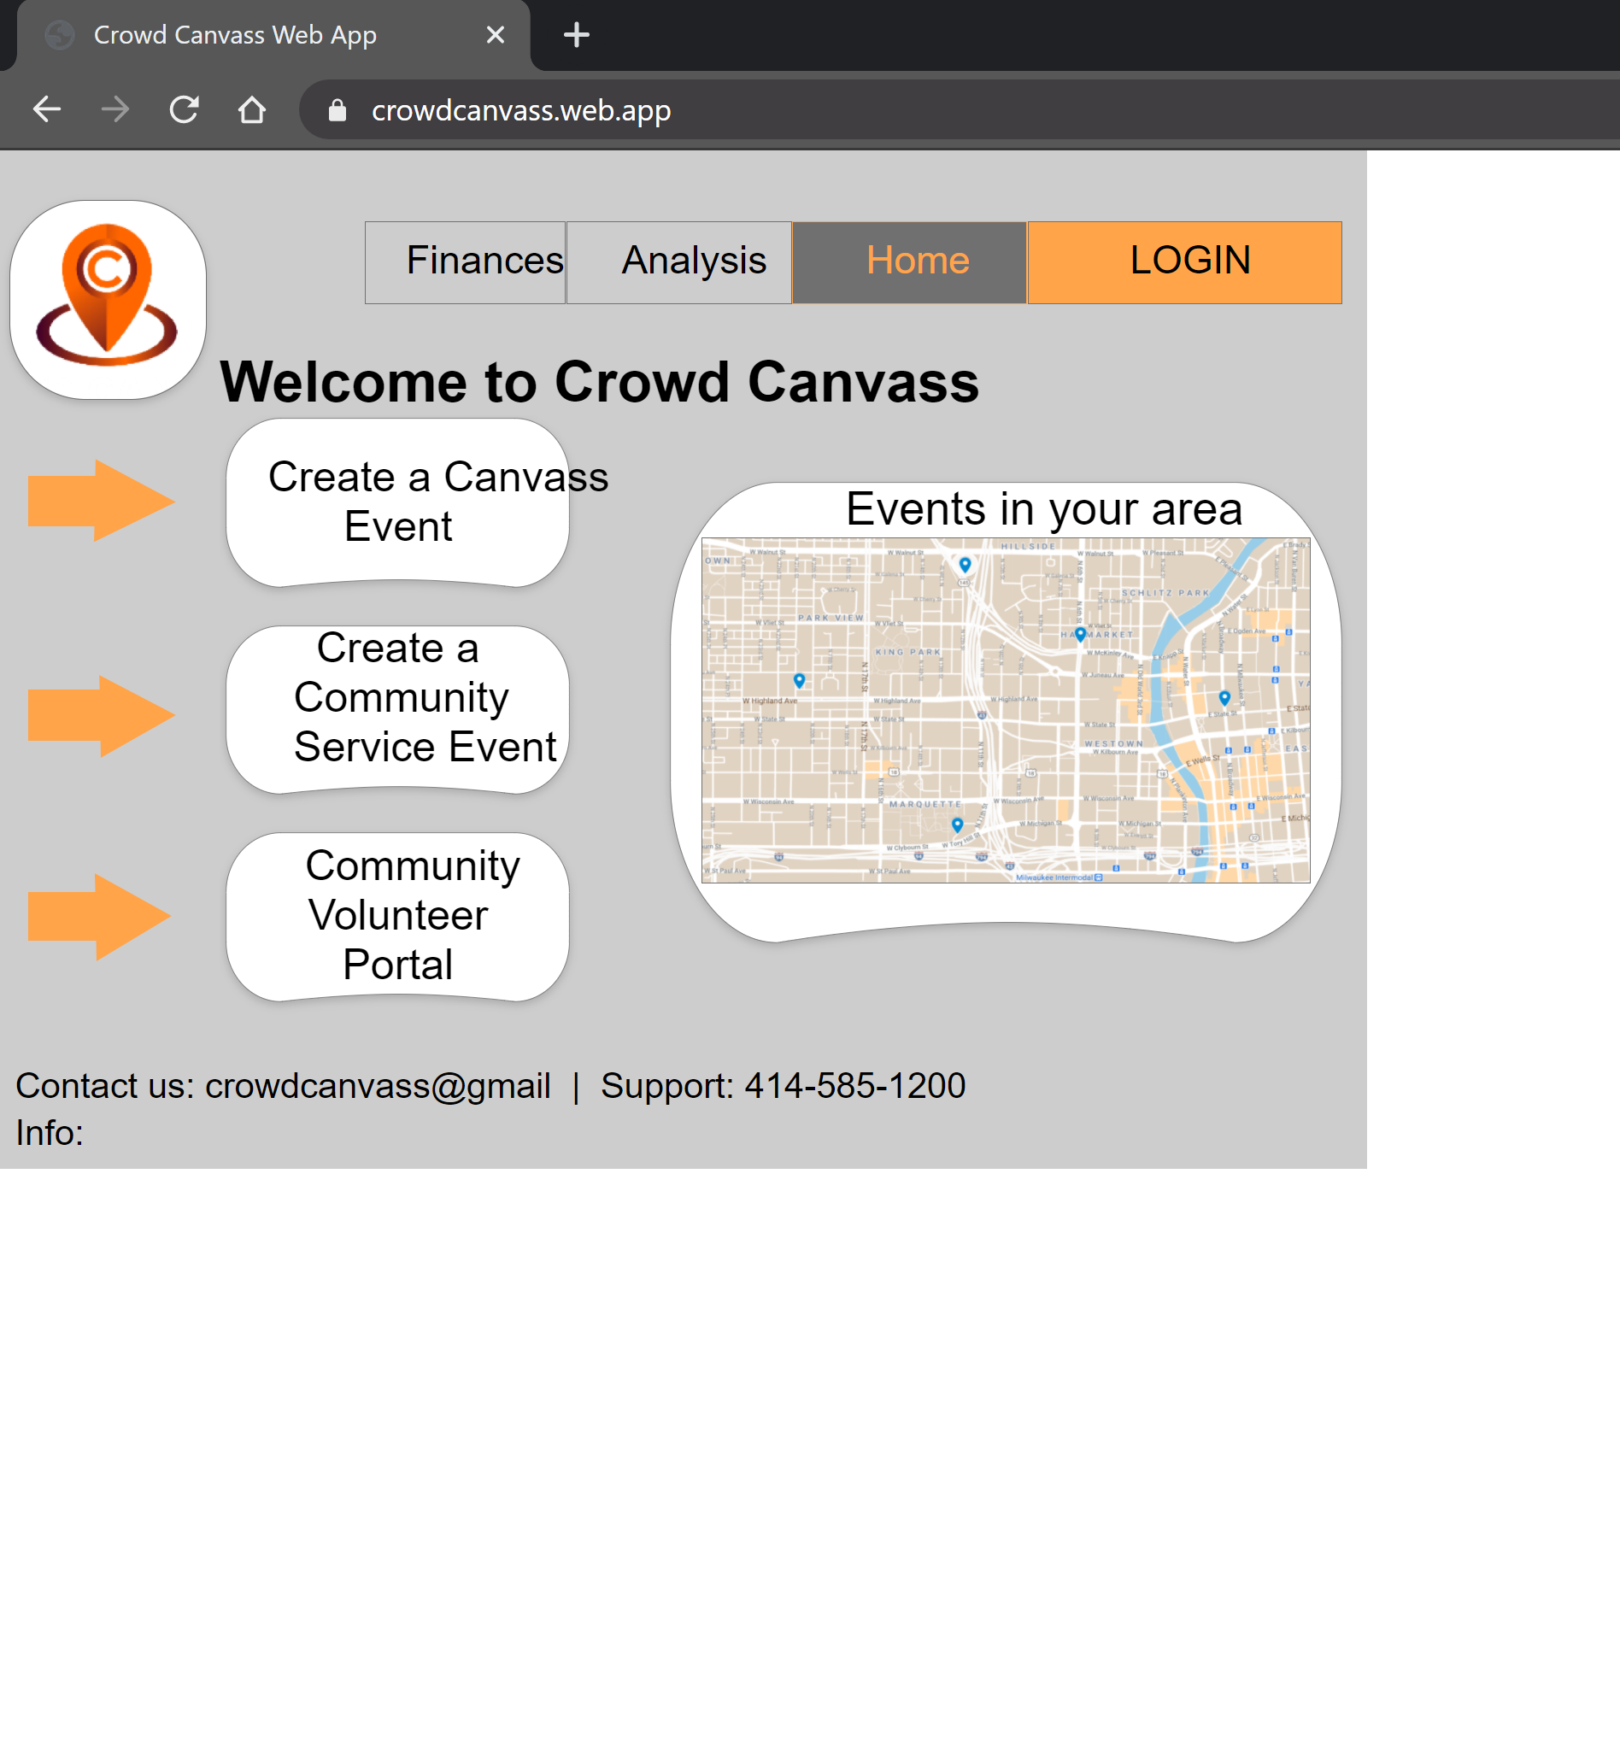
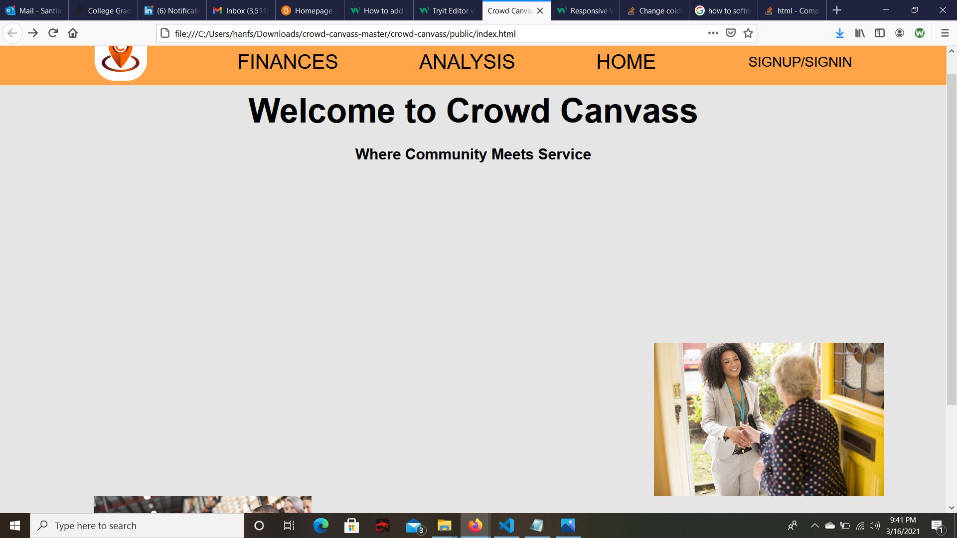
Past 2 Week Sprint Results
Setup login system using a database (firebase) and established connection
Made formatting and aesthetic changes to enable better scaling and visual appeal

Slide 4

Goals for Next two Weeks
Ability to create surveys and have them stored in the database
Ability to reset account password
Continue working on UI overhaul
Research geolocation feature (google maps)

Slide 5

Live Demo
Web Application Link:
https://crowdcanvass.web.app/

